Slide 1
COMPUTER AIDED PROCESS PLANNING
Project Guide :
Mr. Vinod Kumar P P
Group members ,
Neeraj Kumar Singh
Renjini R
Shilpa Femina
Vikash Ranjan
Sweta kumari

Slide 2
CONTENTS
Introduction
Objectives
Modular Design
Advantages
Future scope
Conclusion
References

Slide 3
Introduction
The primary purpose of process planning is to translate the design requirements into manufacturing process details. ( Refer Emad Abouel Nasr et al ^{[4]}.)
Process planning is mainly of two types manual and computer aided process planning (CAPP).
Manual process planning depends on intelligence and experience of process engineer, with no automation.
CAPP (Computer Aided Process Planning) is the method that is mainly used by industries to sequence processes without human intervention.
CAPP is basically CAD/CAM integration, in which we generate drawings through CAD and give that as an input to CAPP system to generate the datasheet which contains the sequence of processes required by CAM to manufacture the parts.

Slide 4
Introduction continued.
CAPP System:
identifying object and processes with CAD drawing.
Process plan fed to CAM .
CAD :
Input CAD drawing
CAD CAM integration in CAPP.

Slide 5
Introduction continued.
CAPP is basically of two types , variant and generative CAPP.
Variant Process Planning: In this approach, process plan for a new part is generated by recalling, identifying and retrieving an existing plan for a similar part and making necessary modifications for new part. If feature of object is not stored in the database then the new processes are created by the process engineer and entered in the database.
Generative Process Planning:In Generative Process Planning, process plans are generated by means of decision logic, formulas, technology algorithms, and geometry based data to perform uniquely processing decisions.

Slide 6
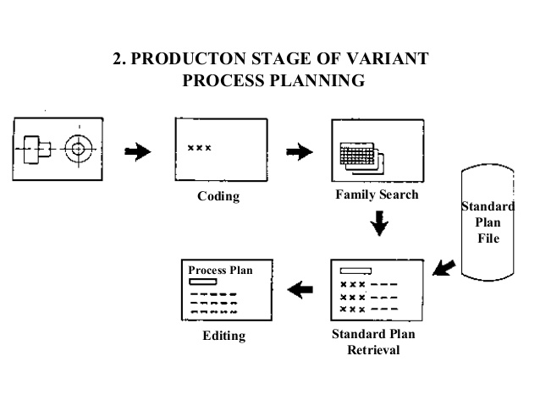
Variant process planning.

Slide 7
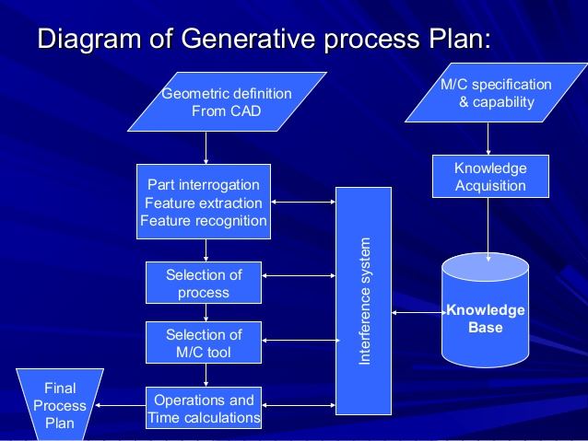

Slide 8
Objectives
Reduce the human effort by eliminating the need of manual input in process planning before manufacturing. (Reiter, 2003; Rouibah & Casekey, 2003)^{[1]}.
Separating the designing phase from the manufacturing phase.
Computer Aided Process Planning (CAPP) systems can help to reduce planning time and increase consistency and efficiency. (Nagaraj & Gurumoorthy , 2002)^{[2]}
Developing an universally adaptable approach of process planning.

Slide 9
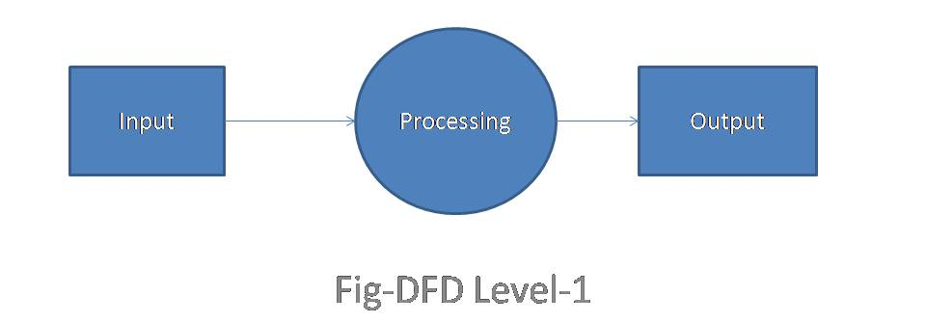
Modular Design
The proposed software is divided into 5 modules which includes taking input drawing file , processing the drawing and generating the output datasheet.

Slide 10
Modular Design continued.
Extraction module
Object Identification Module
Object-Process Mapping Module
Process sequencing Module
Output Generating Module

Slide 11
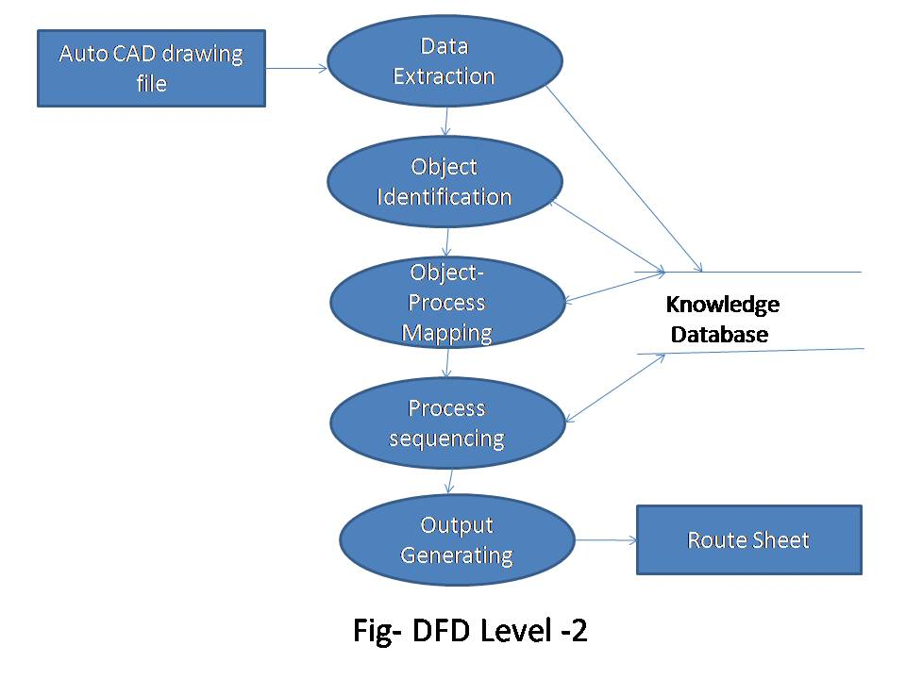
Modular Design continued.

Slide 12
Extraction Module
Objective:
Format of file to be taken as input ,CAD file.
Type of data to extract, Geometric and non Geometric data.
Extraction algorithm to extract data from DXF or IGES input file.
Integrate all the recognized information and represent it into an object oriented feature based format.

Slide 13
Extraction Module
Extraction Approaches:
Many approaches have been proposed in previous such as AUTOFEAT algorithm, feature recognition, Intelligent Feature Recognition Methodology (IFRM), a part recognition algorithm and graph theory-based approach in order to solve the integration issue between CAD and CAM.(Refer Mohamad Faizal Ab. Jabal ^{[3]})
AUTOFEAT solves the problem on how to extract non-geometry information and how to organize the extracted geometry and non-geometry information inside the database.

Slide 14
Extraction Module continued..
Geometric data contained lines, curves and vertex. While non-geometric data include texts, colors, thickness and layers , this also tells about material property.
Unlike AUTOFEAT algorithm Feature Recognition can not extract non-geometric information although it is successful in extracting geometric information.
Graph theory-Based approach only focuses on the arcitechture of CAD drawing.
Part Recognition Algorithm can extract the geometrics and nongeometrics information but it still has a limitation of the assembly information of product

Slide 15
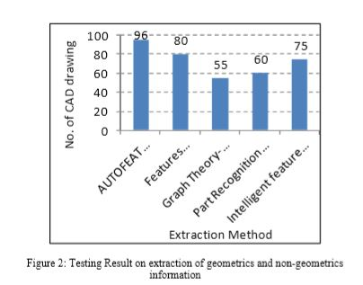
Extraction Module continued..
Fig: Testing Result on extraction of geometrics and non-geometrics information

Slide 16
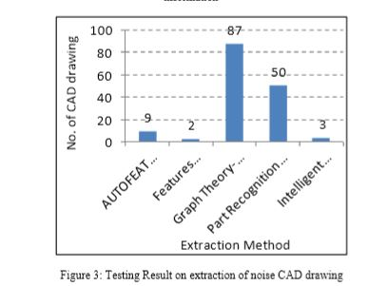
Extraction Module continued..
Fig: Testing Result on extraction of noise CAD drawing viz incomplete drawings or incorrect symbols used.

Slide 17
Extraction Module continued..
AUTOFEAT algorithm is only able to extract 9 out of 100 drawing. This is because this method assumes all the drawing to be extracted must be clear from the errors.
The same situation is reflected in the Features Recognition method and was produced the lowest extraction result of drawings with noise. The approach is capable to extract 2 out of 100 drawings.
The Graph Theory-Based Approach was able to efficiently extract 87 out of 100 drawing.
The Part Recognition algorithm where it uses the FORM technique for the extraction process . FORM technique will list out all the information gathered from the drawing.

Slide 18
Object Identification Module
Objectives :
Identify the object based on the data provided by the extraction module.
Identification of family of parts to which the identified object belongs , with the help of a part recognition algorithm.
Identify the parts which are not belonging to any defined families.

Slide 19
Object Identification Module
Approaches :
Part Recognition Algorithm recognizes the parts designed in a CAD drawing through an expert system.
Group Technology is used to identify the parts having similar properties and group them into families.
GT is a management philosophy that attempts to group products with similar design and/or manufacturing characteristics.
Group technology or GT is a manufacturing technique in which parts having similarities in geometry, manufacturing process and/or functions are manufactured in one location using a small number of machines or processes.

Slide 20
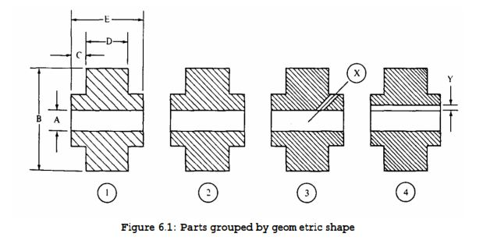
Object Identification Module continued.
Group Technology
Geometric classification of families is normally based on size and shape, while production process classification is based on the type, sequence , and number of operations.

Slide 21
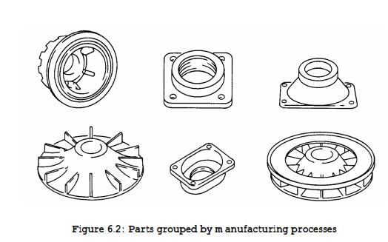
Object Identification Module continued.
The identification of a family of parts that has similarities permits the economies of scale normally associated with mass production to be applied to small-lot, batch production. Therefore, successful grouping of related parts into families is a key to implementation of the group technology philosophy.

Slide 22
Object Identification Module continued.
There are at least three basic methods that can be used to form part families:
1. Manual visual search
2. Production flow analysis
3. Classification and coding
Production flow analysis (PFA) is a structured technique developed for analysis the sequence of operations (routings) that parts go through during fabrication.
Parts that go through common operations are grouped into part families. Similarly, the machines used to perform these common operations may be grouped as a cell.
This is an M x N matrix, where M = number of machines N = number of parts
x = 1 if part j has an operation on machine i; 0 otherwise.

Slide 23
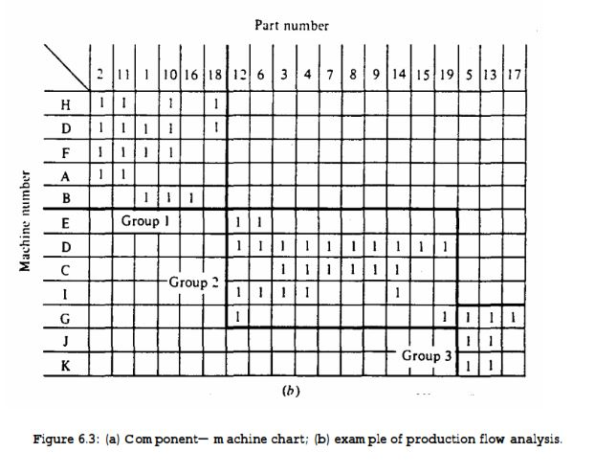
Object Identification Module continued.

Slide 24
Object Identification Module continued.
Classification of parts is the process of categorizing parts into groups, sometimes called families, according to a set of rules or principles. The objectives are to group together similar parts and to differentiate among dissimilar parts.
Coding of a part is the process of assigning symbols to the part. These symbols should have meanings that reflect the attributes of the part, thereby facilitating analysis.
Although well over 100 classification and coding systems have been developed for group technology applications, all of them can be grouped into three basic types:
1. Hierarchical or monocode
2. Attribute or polycode.
3. Hybrid or mixed

Slide 25
Object Identification Module continued.
Hierarchical Code: In this type of code, the meaning of each character is dependent on the meaning of the previous character; that is, each character amplifies the information of the previous character. Such a coding system can be depicted using a tree structure.
Attribute code is also called a polycode, The meaning of each character in an attribute code is independent of any other character; thus, each attribute of a part can be assigned a specific position in an attribute code.
Hybrid Code most coding systems use a hybrid (mixed) code so that the advantages of each type of system can be utilized

Slide 26
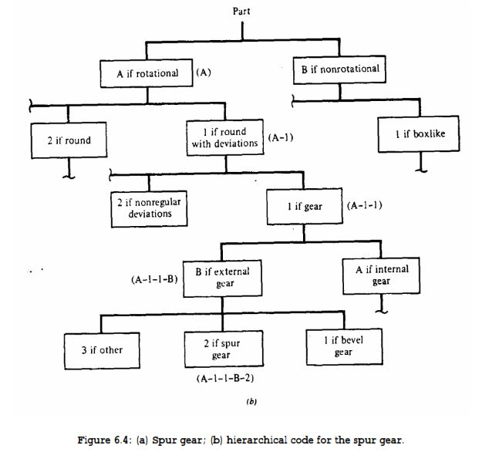
Hierarchical coding.

Slide 27
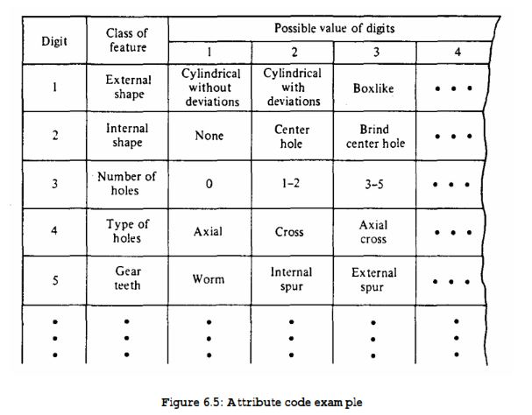
Attribute code .

Slide 28
Object-Process Mapping Module
Objectives :
Intelligent Feature Recognition Methodology (IFRM) is used to communicate with different CAD/CAM system.
Addresses how the machining operations, machines, and tools associated for each recognized feature are identified
At first we should generate the geometrical attributes of the designed part by CAD system and save them into a geometrical attributes file.Then the feature recognition program will be executed to read and interpret this geometrical attributes and transform them into design information(geometrical reasoning approach)

Slide 29
Object-Process Mapping Module
Approaches :
Each feature/ part is mapped with processes involved in creating that feature/ part.
In this approach machining volume (V) for each extracted manufacturing feature is calculated.
Cellular manufacturing is the approach used in object-process mapping which maps each object or part family to the set of machines or processes required to manufacture that part family.

Slide 30
Object-Process Mapping Module
Approaches:
Include a machine learning algorithm to recognize the objects that have been already mapped and need not waste time on mapping processes to those objects.
A map of features to machining information is defined.The mapped machining operations & tools will indicate the machine to be used in machining the feature.The machining volume (V) for each extracted manufacturing feature is calculated.

Slide 31
Process Sequencing Module
Objectives :
Heuristic sequencing algorithms are used to sequence processes to get the sequence of processes with minimum cost(such as time, machines required for processing).
To determine the natural order based on geometrical, operational, tool, geometrical machining constraints.
Machining order is also determined in this module.

Slide 32
Process Sequencing Module
Approaches :
To determine the optimal sequence, various classical techniques like branch and bound methods, linear programming, and dynamic programming.
Usher and Bowden [5] presented an approach for operation sequence coding that permits the application of genetic algorithm (GA) for quick determination of optimal, or near-optimal, operation sequences for parts having varying complexity.
We use heuristic approach , the sequencing problem is non-polynomial complete (NP-complete) which is not feasible to solve this problem using analytical approach. This approach minimizes setup time.
The least cost optimal process route was identiﬁed by Hamilton path of precedence graph

Slide 33
Process Sequencing Module
Approaches:
Foerster et al[6] used simulated annealing for order spread minimization in sequencing cutting patterns (OSMP) which is classiﬁed as NP-complete problem and it can be considered as generalized Travelling-Salesman Problem (TSP).
Li et al. [7] investigated the application of constrained-based tabu search approach for optimization of process plans.
Further it was investigated by Krishna and Rac [10]using Ant colony algorithm (ACA) and found that the computational time has considerably reduced.
Guo et al. [8] applied particle swarm optimization (PSO) for operation sequencing problem, and concluded that there is still potential for further improvement in computation eﬃciency.
Nallakumarasamy et al. [9]investigated the operation sequencing problem using simulated annealing technique (SAT) and concluded that SAT is superior to GA and ACA

Slide 34
Process Sequencing Module
Ganesh and Punniyamoorthy [11] developed a hybrid GA SA algorithm and found that the algorithm performs better. Among these heuristic methods, Genetic Algorithms and simulated annealing represent powerful combinatorial optimization methods with complementary strength and weakness and are naturally motivated , incorporating solution space reduction technique (SSRT)
A relative cost matrix is generated using Operation sequencing and Precedence cost matrix.
Operation Sequencing:The nature of operation sequence generation is to develop a feasible and optimal sequence of operations for a part based upon the technical requirements,including part speciﬁcations in the design, the given manufacturing resources, and certain objectives related to cost or time.
Precedence Matrix: The precedence cost matrix (PCM) is generated for any pair of features based on the appropriate relative costs involved in each attribute. Costs reﬂect various parameters such as tool change, machine change, datum, location etc.

Slide 35
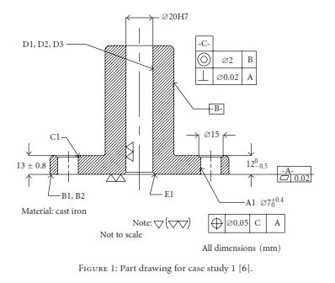
Process Sequencing Module

Slide 36
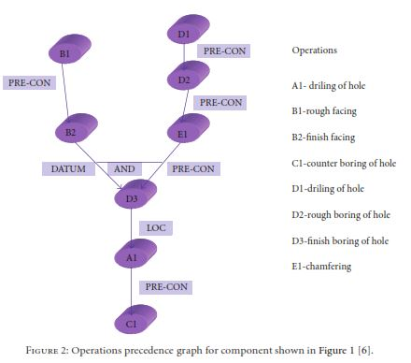
Process Sequencing Module

Slide 37
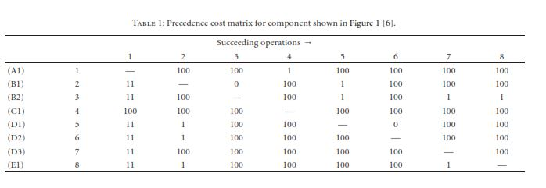
Process Sequencing Module

Slide 38
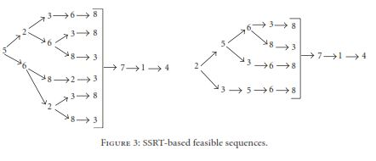
Process Sequencing Module

Slide 39
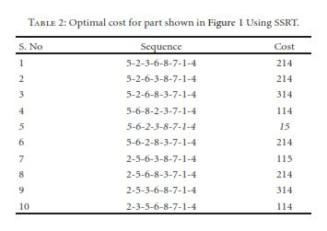
Process Sequencing Module

Slide 40
Output Generating Module
Objectives:
Route sheet is produced as an output.
Routings which specify operations, operation sequences, work centers, standards, tooling and fixtures.
Process plans which typically provide more detailed, step-by-step work instructions including dimensions related to individual operations, machining parameters, set-up instructions, and quality assurance checkpoints.

Slide 41
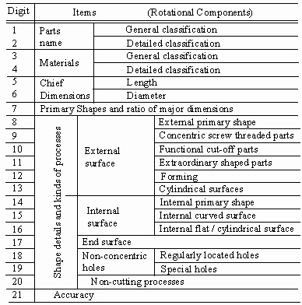
Output Generating Module Conti..

Slide 42
Knowledge Representation
Introduction :
As we discussed , There are two approaches to the automation of process planning:
Variant
Generative.
The variant approach is older and is based on the assumption that for a given part design there may be some similar parts that have been produced in the past.

Slide 43
Knowledge representation continued
The generative approach uses a different method. It produces an entirely new process plan for the new part design based on the design data and the available process planning knowledge.
This approach may use various ways to represent knowledge, decision tables, decision trees or AI techniques when it is called knowledge based process planning.
The main direction in developing a generative process planning system has been to use a rule based approach.

Slide 44
Knowledge Representation Continued
Manufacturing knowledge base which consists of frame representation of knowledge that connects processes, machines, and tools.
Knowledge representation scheme for process planning provides systematic links between design, process planning, and scheduling functions and allows their simultaneous execution in concurrent engineering environment.

Slide 45
Knowledge Requirements In Process
Planning
Various forms of knowledge used in process planning relate to the objects (entities in the manufacturing environment) and connections between them.
They include the knowledge of part design, manufacturing operations, tools, machines, and the relationships between these entities.

Slide 46
Advantages
Increased productivity of process planners.
Reduction in process planning effort
Savings in direct labor
Savings in material
Process rationalization and standardization
Reduced process planning and production lead time; faster response to engineering changes
Greater process plan consistency, access to up to date information in a central database

Slide 47
Advantages Continued
Improved cost estimating procedures and fewer calculation errors
More complete and detailed process plans
Improved production scheduling and capacity utilization
Improved ability to introduce new manufacturing technology and rapidly update process plans to utilize the improved technology

Slide 48
Future Scope
Generative or dynamic CAPP is the main focus of development, the ability to automatically generate production plans for new products
Dynamically update production plans on the basis of resource availability.
It use iterative methods, where simple production plans are applied to automatic CAD/CAM development to refine the initial production plan.

Slide 49
Conclusion
Extracted data is not accurate when the drawing is an incomplete drawing or contains the noise such as unwanted lines or any shapes cross the object in the drawing.
A complete product can be manufactured by the most efficient ways from design stage until manufacturing stage.
Feature recognition plays a key factor towards achieving the integration of design and manufacturing.

Slide 50
Reference
[1]. J.D Tedford & T J Ferris ,” The Application Of Group Technology at the Production Planning Phase of a new Product “ , November 1976
[2].Shu-Chu Liu and Shih-Yaug Liu ,” A Heuristic Approach for Automated Process Sequencing in CAPP ” , MIS Department, Pingtung Polytechnic Institute, Pingtung, 91207, Taiwan, 1996 IEEE
[3].V.Fecova, J. Novak-Marcincin, M. Janak, J. Barna and L. Novakova-Marcincinova, “ Computer Aided Manufacturing Process Planning by Group Technology Application ”, 15th International Conference on Intelligent Engineering Systems , 2011
[4].Emad Abouel Nasr, Abhay Vijayan and Ali K. Kamrani,”A Feature-based approach for integrated Product design & Process planning “,Proceedings of the 34th International Conference on Computers & Industrial Engineering.

Slide 51
References
[5] J. M. Usher and R. O. Bowden, “The application of genetic
algorithms to operation sequencing for use in computer-aided
process planning,” Computers and Industrial Engineering, vol.
30, no. 4, pp. 999–1013, 1996.
[6]. H. Foerster and G. Wascher, “Simulated annealing for order¨
spread minimization in sequencing cutting patterns,” European Journal of Operational Research, vol. 110, no. 2, pp. 272-281, 1998.
[7]. W. D. Li,S. K. Ong, and A. Y. C. Nee, “Optimization of process plans using a constraint-based tabu search approach,”International Journal of Production Research, vol. 42, no. 10, pp.1955–1985, 2004.

Slide 52
References.
[8]. Y. W. Guo, A. R. Mileham, G. W. Owen, and W. D. Li“Operation sequencing optimization using a particle swarm optimization approach,” Proceedings of the Institution of Mechanical Engineers , Part B: Journal of Engineering Manufacture, vol. 220, no. 12, pp. 1945–1958, 2006.
[9]. K. Ganesh and M. Punniyamoorthy, “Optimization of continuous—time production planning using hybrid genetic algorithms—simulated annealing,” The International Journal of Advanced Manufacturing Technology, vol. 26, no. 1-2, pp.
148–154, 2005

Slide 53

.

